Slide 1
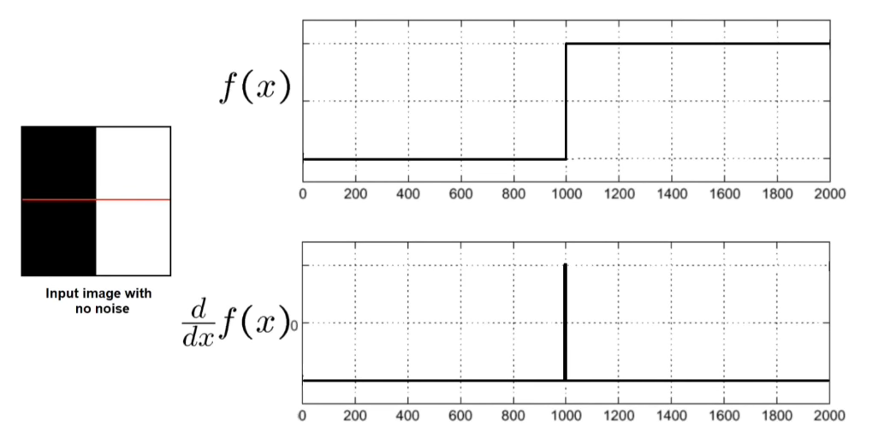

Slide 2
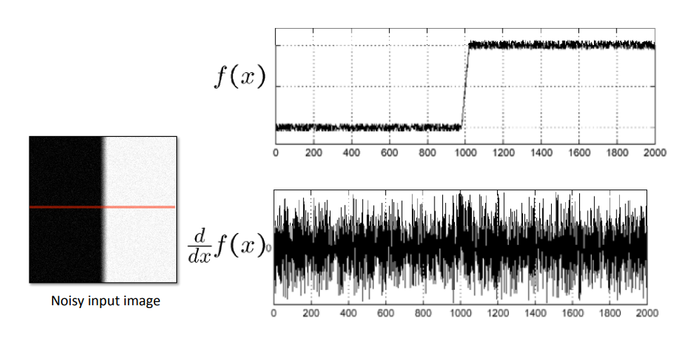

Slide 3
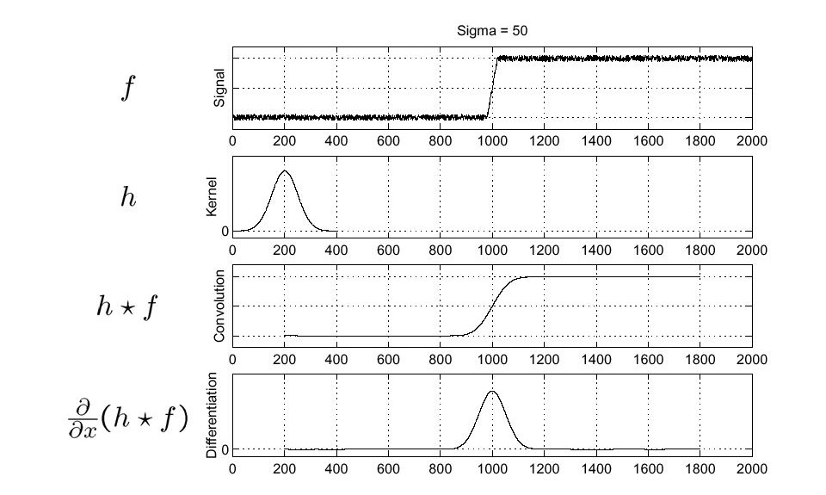

Slide 4
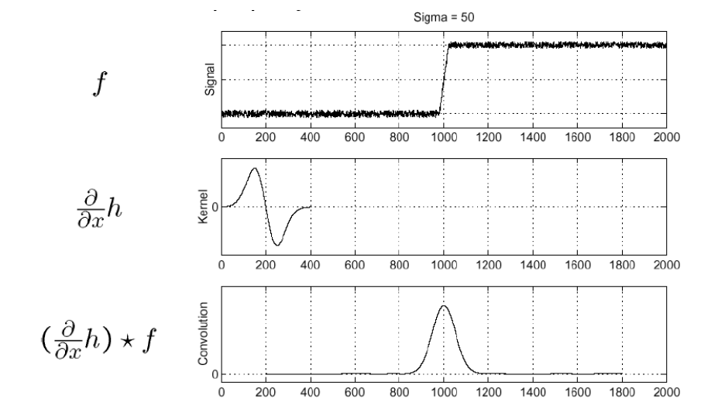

Slide 5
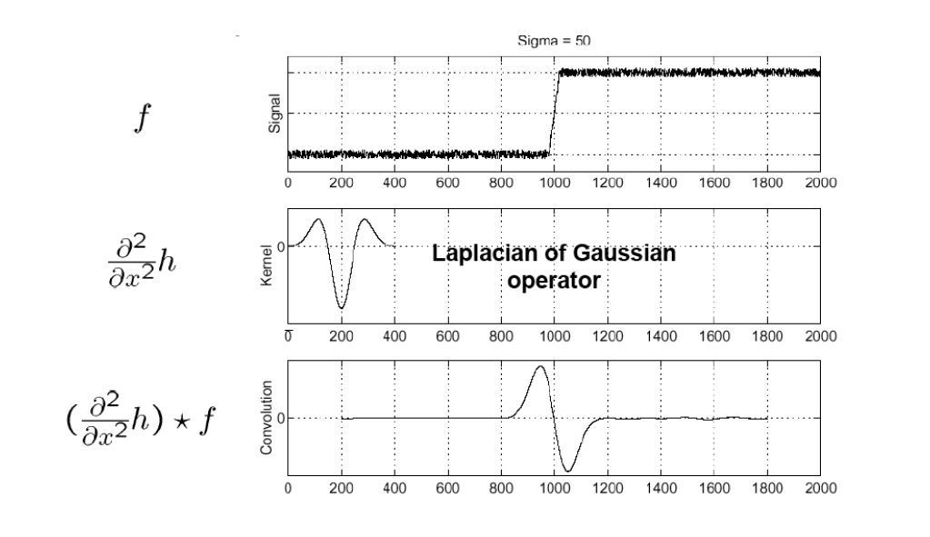

Slide 6
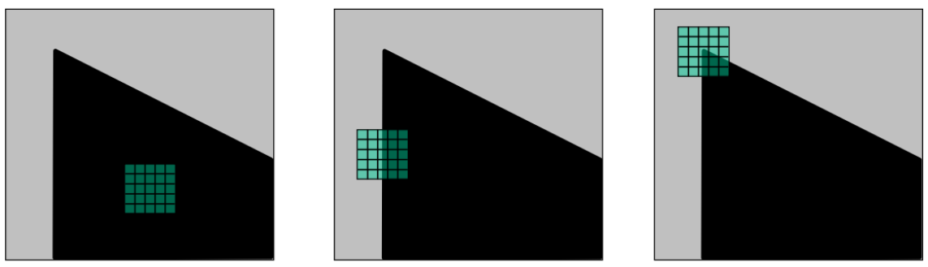
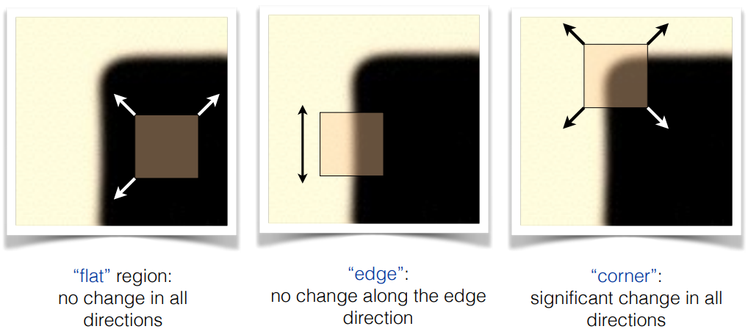

Slide 8
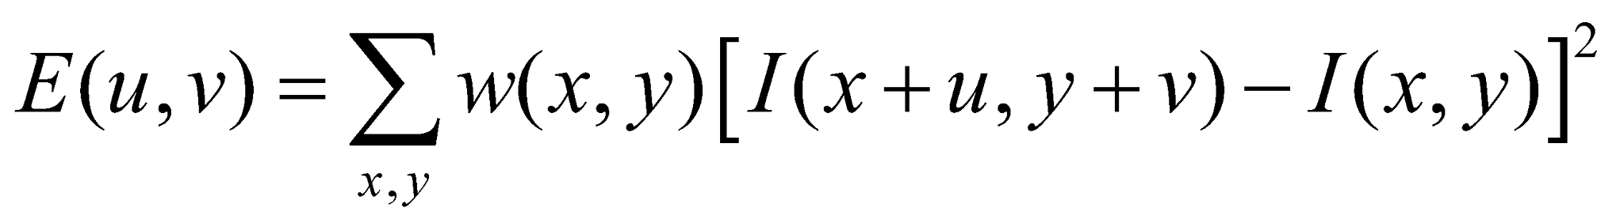
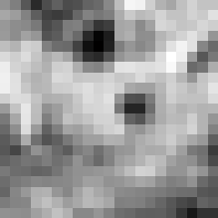

Corner Detection by Auto-correlation
Change in appearance of window w(x,y) for shift [u,v]:
I(x, y)
E(u, v)
E(0,0)
w(x, y)
Notes:
To understand this visually, we have our image. We take a region within the image (the red box), and define a window function (let’s just say all 1). This is the computed auto-correlation image. To get this, we say that the (u, v) is located in the center in the red box. Everything to the left and bottom is negative, and everything to the right and top is positive.

Slide 9
Corner Detection by Auto-correlation
Change in appearance of window w(x,y) for shift [u,v]:
I(x, y)
E(u, v)
E(3,2)
w(x, y)
Notes:
If we look at another sub-image, then we can still use the same equation. To compute the value (3, 2) from the right image, then that means we would look at a different window in the left image. To compute the auto-correlation at (3, 2), we have to look outside the red window in the original image. If our “red box” goes outside the image, then we would need to pad the image.

Slide 10
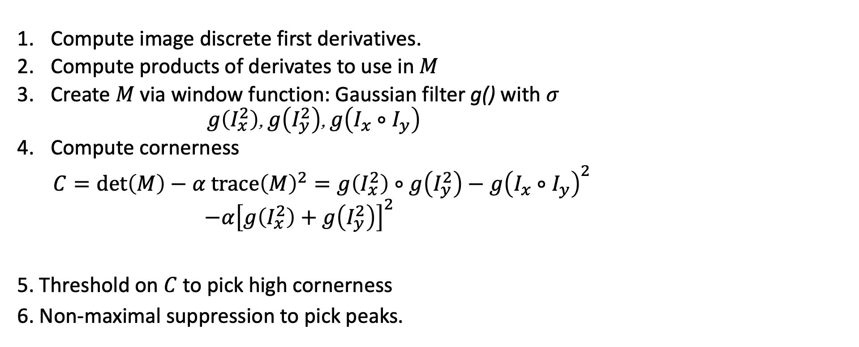
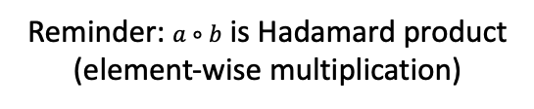
Harris Corner Detector
Compute image discrete first derivatives.
Compute products of derivates to use in $M$
Create $M$via window function: Gaussian filter g() with $σ$
$g\left(I_{x}^{2}\right)$, $g\left(I_{y}^{2}\right)$, $g\left(I_{x}∘I_{y}\right)$
Compute cornerness
$C=\det\left(M\right)−α trace{\left(M\right)}^{2}=g\left(I_{x}^{2}\right)∘g\left(I_{y}^{2}\right)−g{\left(I_{x}∘I_{y}\right)}^{2}$
$−α{\left[g\left(I_{x}^{2}\right)+g\left(I_{y}^{2}\right)\right]}^{2}$
5. Threshold on $C$ to pick high cornerness
6. Non-maximal suppression to pick peaks.
$$I_{x}∘I_{y}$$
Reminder: $a∘b$ is Hadamard product (element-wise multiplication)
Harris (1988).
Notes:
$a∘b$ is https://en.wikipedia.org/wiki/Hadamard_product_(matrices) Note that $I_{x}^{2}$, $I_{y}^{2}$ are not matrix powers (where matrix power is repeated matrix multiplication of a square matrix with itself). They are just element-wise squaring. This is because M is defined _per pixel_; in the algorithm presented, we store the values of M separately in maps of the individual M components ($I_{x}^{2}$, $I_{y}^{2}$, $I_{x}^{}I_{y}^{}$).
Matrix power
https://en.wikipedia.org/wiki/Matrix_multiplication#Powers_of_a_matrix

Slide 11
